Slide 1
APOLOGETICS
IN ONE LESSON
almost
Ai1L.net

Slide 3
Walter

Slide 4
Mia

Slide 5
Harry

Slide 6
Aiden

Slide 7
Luna

Slide 8
Helen

Slide 9
Mildred

Slide 10
Mason

Slide 11
Dorothy

Slide 12
Donald

Slide 13
Male Names

Slide 14
Female Names

Slide 15
People Names (in the 1st century)

Slide 16
Number of Place Names
False
Gospels
Authentic
Gospels

Slide 17
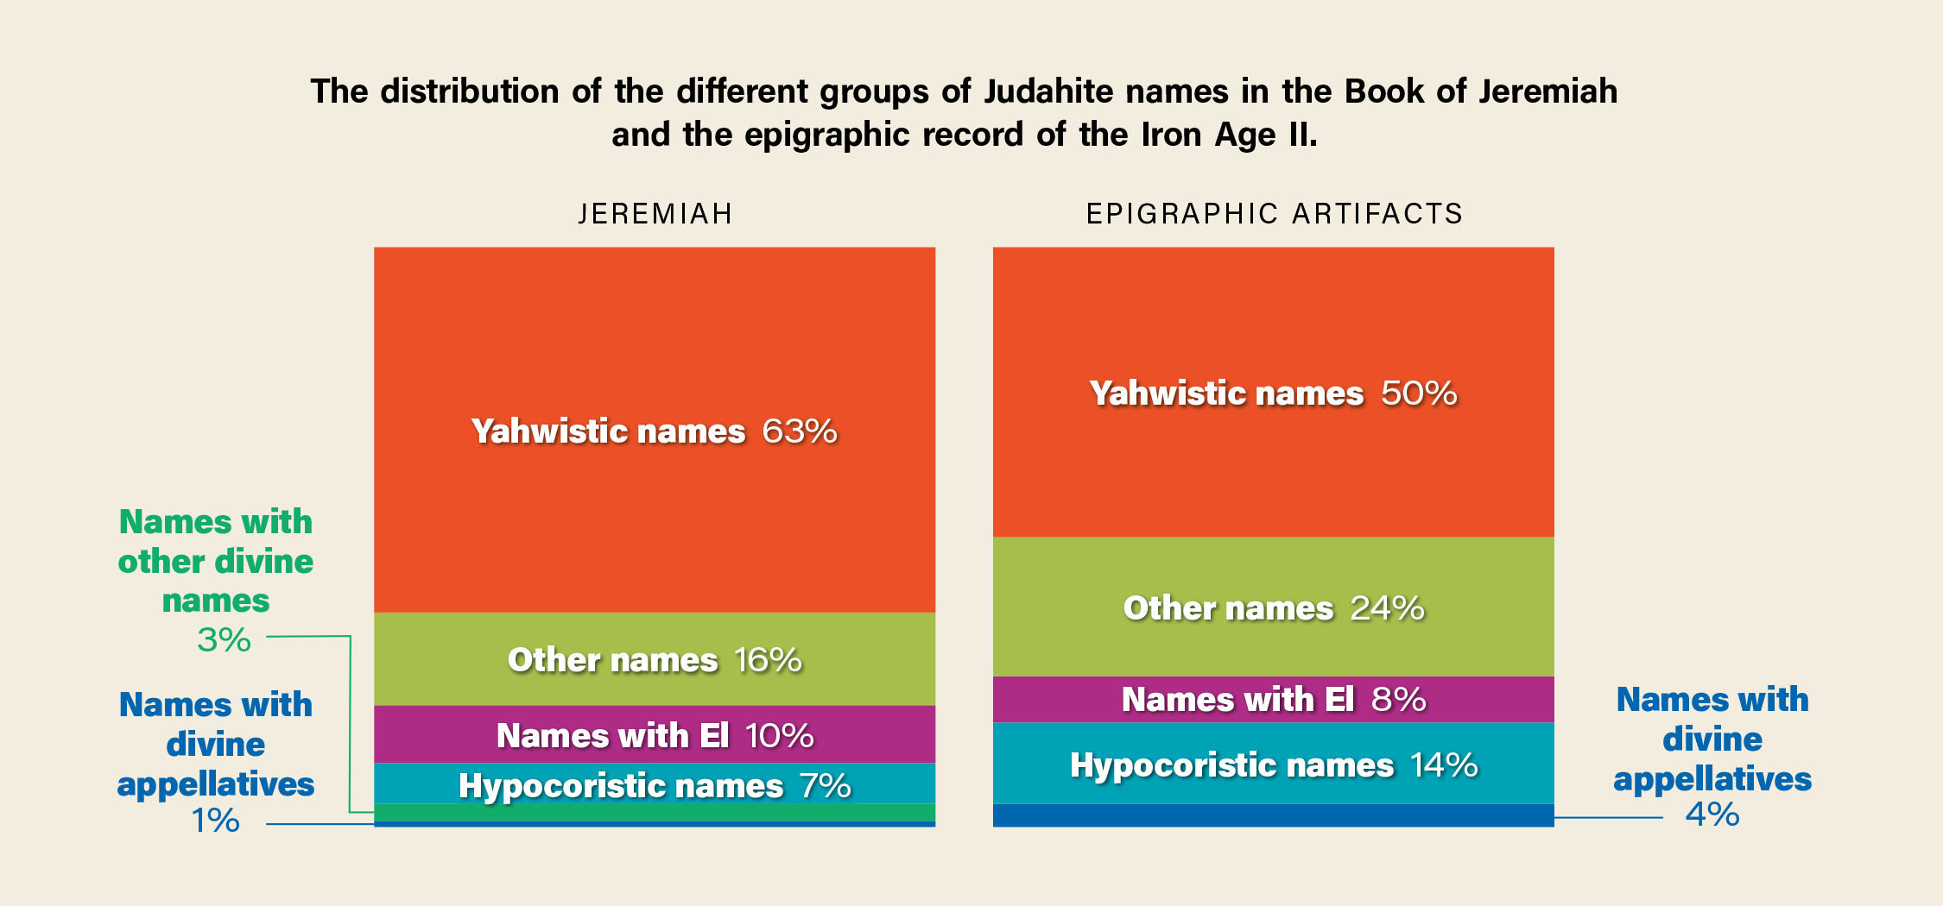

Slide 18
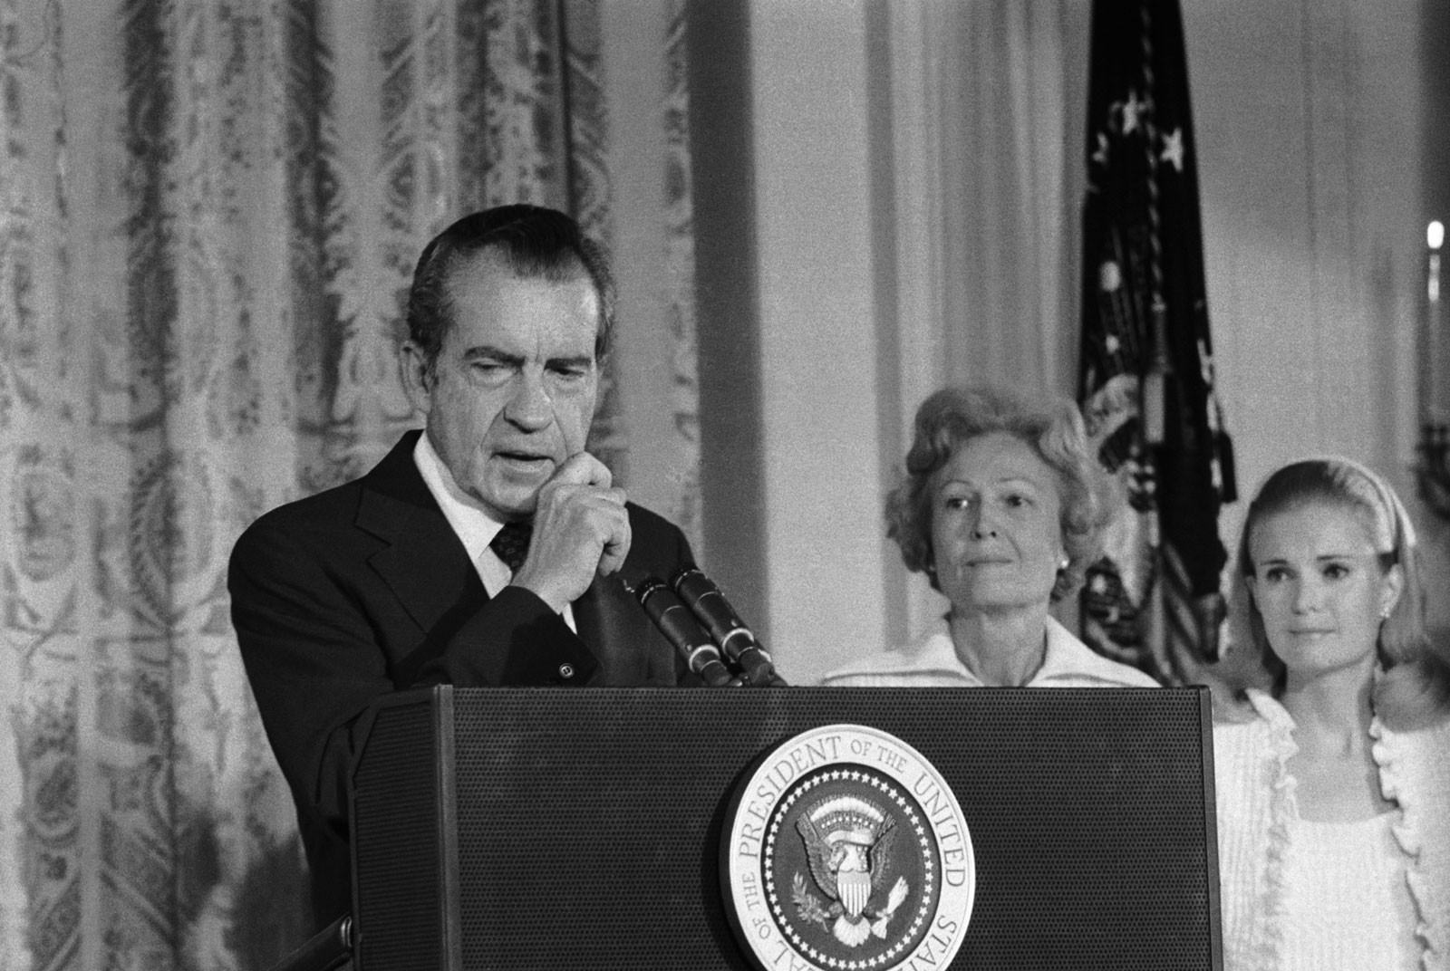
The real cover-up, the lie, could only be held together for two weeks
Chuck Colson, Nixon Aide

